Slide 1

AMAZON SALES ANALYSIS REPORT
Python | PowerBI

Slide 2
Project Details
Project Title | Analyzing Amazon Sales data
Technologies | Data Science
Domain | E-commerce
Project Difficulties level | Advanced
Programming language used | Python
Business Intelligence Tool | Power BI

Slide 3
Problem statement
Sales management has become increasingly important in the face of rising competition and the need for improved distribution methods to reduce costs and increase profits. Efficient sales management is crucial for any commercial or business enterprise. This project aims to analyze Amazon sales data to understand sales trends and identify key metrics that influence sales performance. By exploring various attributes such as sales volume, product categories, and regional distribution, the analysis seeks to provide actionable insights that can enhance decision-making and optimize business strategies.

Slide 4
Objective
Analyze month-wise, year-wise, and yearly_month-wise sales trends.
Identify key metrics and factors that impact sales performance.
Explore meaningful relationships between various sales attributes.
Provide insights that can drive strategic decisions for improved sales management and profitability.

Slide 5
Data preparation
ETL Process
Extract:
The dataset was retrieved from a provided Amazon sales data file containing sales records across different regions and product categories.
Transform:
Data cleansing was performed to handle missing values and inconsistencies.
Date fields were converted into appropriate datetime formats to facilitate trend analysis.
New columns were created to capture the month and year from the order date for time-based trend analysis.
Data aggregation was conducted to prepare for month-wise, year-wise, and yearly_month-wise trend analysis.
Load:
The cleaned and transformed dataset was stored in a format suitable for exploratory data analysis and visualization.

Slide 6
DATASET INFORMATION
The dataset includes the following attributes:
Region: Geographic region where the order was placed.
Country: Specific country within the region where the order was placed.
Item Type: Category of the item sold.
Sales Channel: The channel through which the sale was made (e.g., online, offline).
Order Priority: Priority level of the order (e.g., high, medium, low).
Order Date: Date when the order was placed.
Order ID: Unique identifier for each order.
Ship Date: Date when the order was shipped.
Units Sold: Number of units sold in the order.
Unit Price: Price per unit of the item sold.
Unit Cost: Cost per unit of the item sold.
Total Revenue: Total revenue generated from the order.
Total Cost: Total cost incurred for the order.
Total Profit: Profit earned from the order.

Slide 7
KEY PERFORMANCE INDICATORS (KPIs)
Total Revenue:
Measures overall sales income across all products.
Total Profit:
Net income after all costs, indicating financial health.
Profit Margin:
Percentage of revenue that becomes profit, showing efficiency.
Revenue by Product Category:
Income from each product category, highlighting top sellers.
Revenue by Sales Channel (Online vs. Offline):
Breakdown of revenue from online and offline channels.

Slide 8
INSIGHTS
Demographic Insights: The dataset includes a diverse sample, with a significant representation of middle to older age groups and a balanced gender distribution.
Clinical Parameters: Critical health metrics like blood pressure, cholesterol levels, and maximum heart rate provide a detailed overview of the individuals' health, highlighting potential risk factors for heart disease.
Risk Factors Analysis: Preliminary findings indicate connections between age, gender, chest pain type, and the likelihood of heart disease, with further analysis into exercise-induced angina and ST depression offering deeper insights.
Healthcare Implications: The analysis supports enhanced understanding and early detection of heart disease, paving the way for personalized healthcare strategies that could improve patient outcomes.

Slide 9
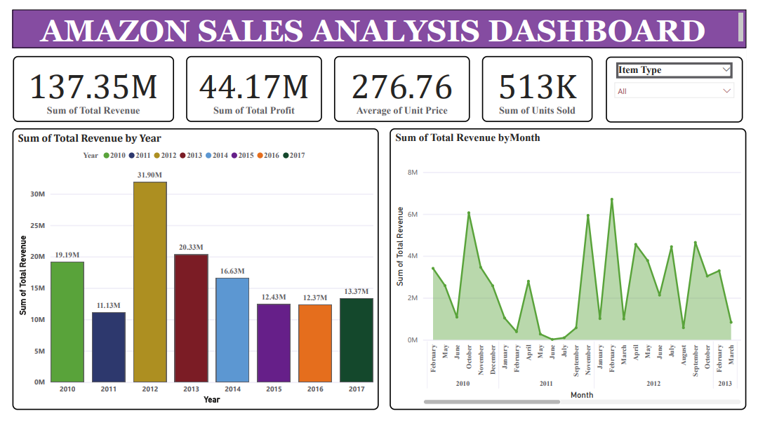

Slide 10
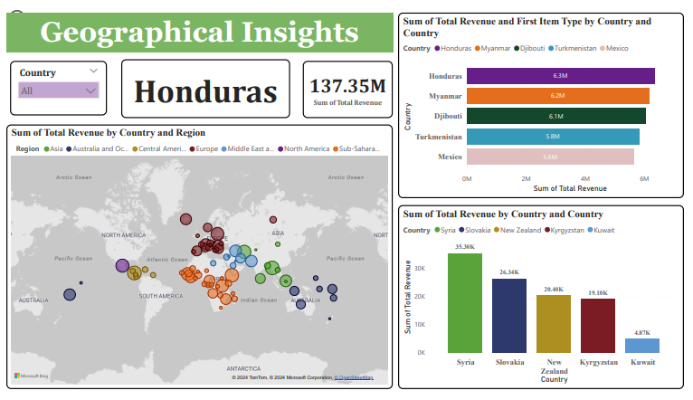

Slide 11
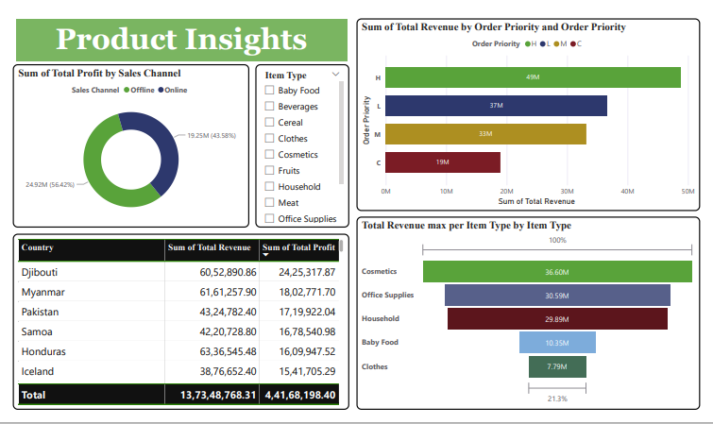

Slide 12
conclusion
The analysis of the Amazon sales data highlights key trends and insights that can be instrumental in enhancing sales strategies and improving overall profitability. The clear dominance of offline sales channels and certain product categories like cosmetics indicates areas of strength, while the underperformance in regions such as North America and product categories like fruits and snacks presents opportunities for growth. The year-wise trend analysis also shows significant fluctuations in both revenue and profit, suggesting the need for more stable and sustained growth strategies. Additionally, the geographical analysis underscores the importance of focusing on both top and bottom-performing regions and countries to optimize global sales performance.

Slide 13
suggestions
Enhance Sales in Underperforming Categories:
Focus on boosting sales in lower-performing categories, such as fruits and snacks, through targeted marketing and promotional campaigns.
Strengthen Online Sales Channels:
Although offline channels are performing well, there is a need to boost online sales to balance revenue streams. This can be achieved through improved online marketing strategies and enhanced customer engagement.
Stabilize Year-over-Year Growth:
Implement strategies to stabilize revenue and profit growth across years, possibly by diversifying product offerings and improving market penetration in regions showing declining trends.
Focus on Underperforming Regions:
Devise targeted strategies to improve sales in regions like North America, which are currently underperforming in both revenue and profit. This could include localized marketing efforts, product customization, or strategic partnerships.
Leverage Top-Performing Regions:
Continue to capitalize on the strengths of top-performing regions like Sub-Saharan Africa by maintaining strong distribution networks and customer relations in these areas.

Slide 14
THANK YOU

